Slide 1



Ed-Tech Overview, Agile & Benchmark Application
By Sumanjali Aluri

Slide 2
Ed-Tech:
Use of Technology to enhance, support and improve teaching, learning and educational administration.
Components
LMS
Digital Content
Collaborative tools
Online courses
Gamification
Adaptive learning

Slide 3
Ed-Tech Standards:
Guidelines for effective use of Educational Technology
SCORM
LTI
xAPI
QTI

Slide 4
SCORM (Sharable Content Object Reference Model):
Packages e-learning content into a standardized format for easy upload and tracking across various LMS platforms.
Packaging
Run- Time
Sequencing

Slide 5
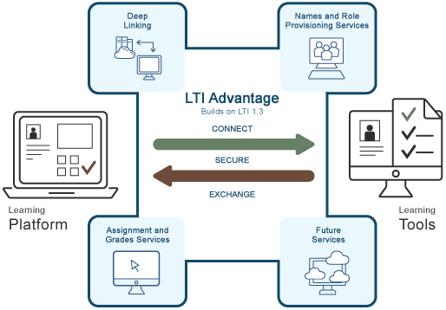
LTI (Learning Tool Interoperability):
To enable the Integration of External tools or content into LMS

Slide 6
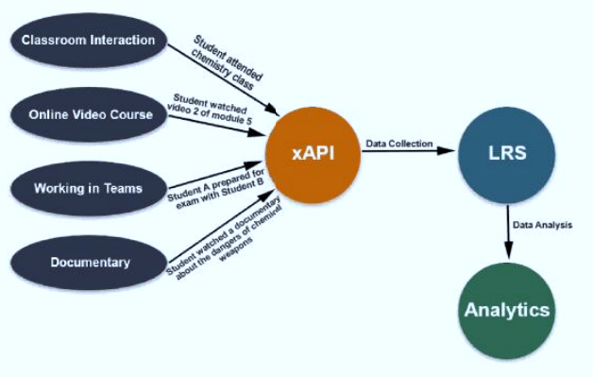
xAPI (Experience API):​
Tracks and reports a wide range of learning experience using detailed “Actor, verb, object” statements, enabling flexible data collection.

Slide 7
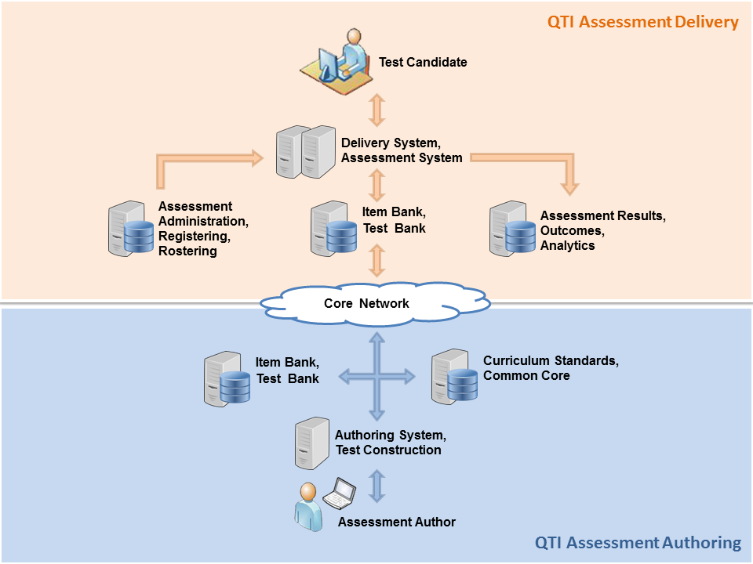
QTI
(Question Test Interoperability):
Standardizes the format for creating and sharing test questions and assessments across LMS and assessment system.

Slide 8
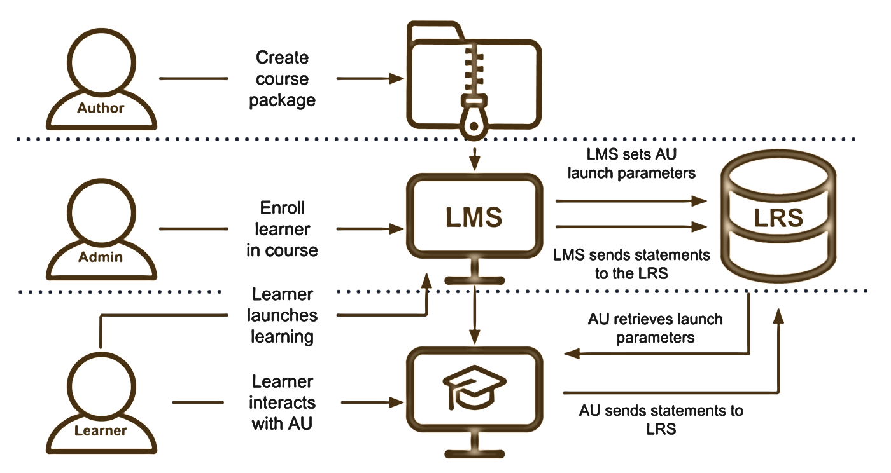
CMI5:
Combines SCORM’s structure with xAPI’s tracking capabilities, offering a modern approach to e-learning content delivery and management.

Slide 9

Standards / Feature | SCORM | LTI | QTI | xAPI | CMI5
Purpose | Track learning activities and content delivery within LMS | Integrate external tools with LMS | Exchange and manage assessment content | Track all learning experiences across multiple platforms | Combine SCORM's structure with xAPI's flexibility
Tracking | Tracks progress, score, and completion inside LMS | Does not track learning activity; integrates tools | Tracks assessments but not broader learning | Tracks a wide variety of learning experiences inside and outside LMS | Tracks learning in LMS and outside using xAPI
Content type | E-learning modules and courses | External learning tools | Quizzes, tests, assessments | All types of learning experiences (formal and informal) | E-learning content, with detailed tracking
Interoperability | Works within SCORM-compliant LMS | Integrates third-party tools with LMS | Exchange of assessments between systems | Interoperability between different platforms and tools | Combines SCORM content with xAPI tracking
Storage | Stored within LMS | Does not store data directly | Stored in assessment systems | Stored in an LRS | Stored in LRS, like xAPI
Sequencing | Supports content sequencing | Does not handle sequencing | No sequencing for learning content | Does not provide content sequencing | Supports content sequencing and delivery
Adoption | Widely used and well-established | Growing in popularity, especially in tool integration | Mainly used for assessments | Gaining popularity for modern learning environments | Newer, but gaining traction in advanced learning systems

Slide 11
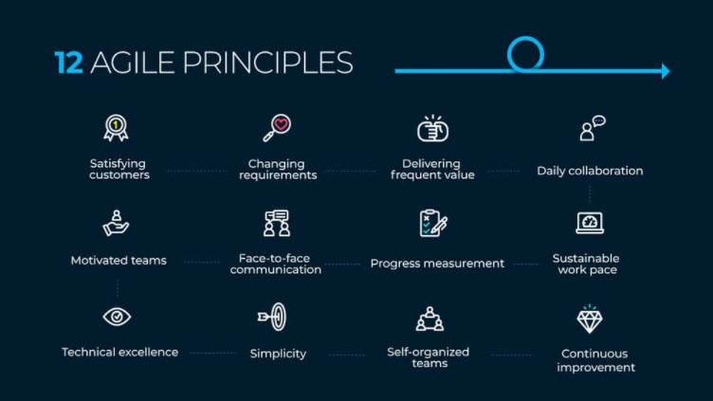
Agile:
Agile is a project management and software development approach emphasizing iterative progress collaboration and flexibility.
Agile Values:
Individuals & nteractions > Process & Tools Working software > documentation Customer collaboration > Contract negotiation Respond to change > Following a plan

Slide 12
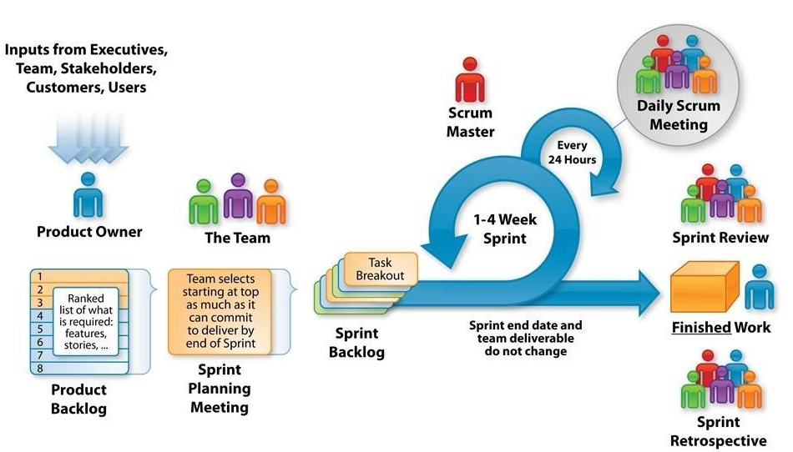
SCRUM Ceremonies:
Sprint Planning
Daily Stand-up
Sprint Review
Sprint Retrospective

Slide 13
Benchmark:
Benchmark Education company provides students and teaches with the resource they need to become problem-solvers, decision-makers, and joyful learners.
Benchmark Universe
Assignment
Assessment
Reporting
BOC & PD Scheduling
Licensing
CMI5

Slide 14
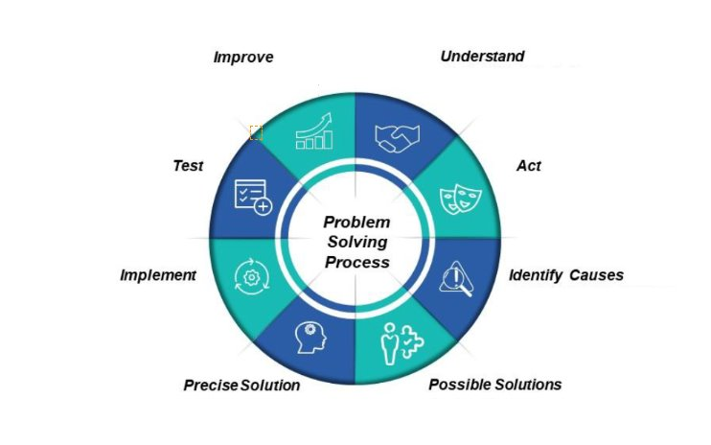
Problem Solving:
Techniques used to solve problem:
Brainstorming
Pareto’s Law
Divide and conquer
5W’s and H

Slide 15

THANK YOU

